Slide 1

Evolution of Test Cricket – An analysis based on match results

Slide 2
About me
Background - B-tech (ECE, 2016-20)
I chose Data Science as my professional field because of my passion for Math and AI
I have 1 year of experience in IT industry
Have worked as ‘Associate Software Engineer’ in ‘Accenture’(hyd) from Jul, 2021 – Mar, 2022
Have worked as ‘Software Engineer Trainee’ in ‘Ivy Comptech Pvt. Ltd.’(hyd) from Jan, 2021 – Apr, 2021

Slide 3
Agenda
Evolution of Test Cricket based on match results from 2013-2022.
Analysis of results of test matches played from 2013-2022 by years and various teams.
The data required for analysis has been extracted from ‘https://stats.espncricinfo.com’.
The data consists of 419 rows and 7 initial columns/features(Team1, Team2, Margin, Ground, Match Date, Scorecard).

Slide 4
Exploratory Data Analysis:
Data Cleaning Steps -
Dropping duplicates and filling the N/A values of ‘Margin’ column with ‘Doesn’t Exist’ were the steps involved in Data cleaning.
Data Manipulation Steps –
As a part of Data Manipulation, ‘Start Date’, ‘End Date’, ‘Match Duration(in Days)’(limited to 5), ‘End Year’ , ‘Match Drawn’ columns were added to the dataframe.

Slide 5
Exploratory Data Analysis: (contd.)
Bivariate Analysis Steps –
As a part of bivariate analysis, various combinations of grouping has been done to plot the following graphs –
A bar plot to show the number of matches played yearwise and teamwise.
Separate bar plots to show the yearwise and teamwise distribution of drawn matches.
bar plots to show the yearwise distribution of drawn matches, teamwise
Pie charts to show Yearwise distribution of number of matches played, teamwise.

Slide 6
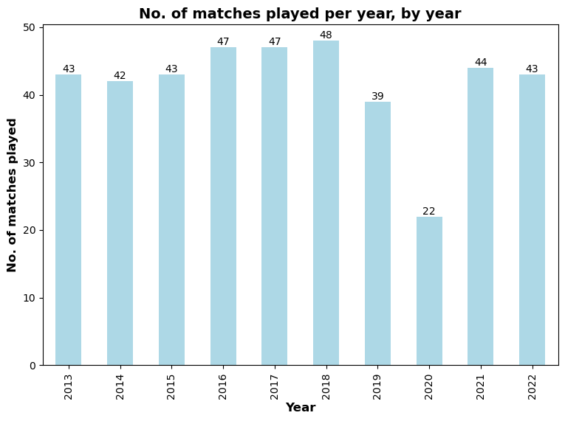
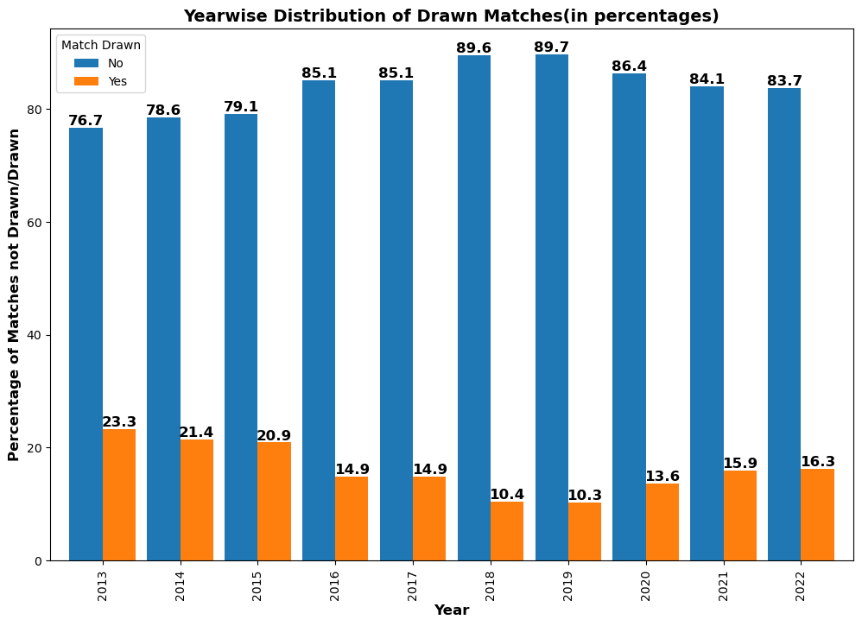
Exploratory Data Analysis: (contd.) plots describing no. of matches played and distribution of drawn matches yearwise.

Slide 7
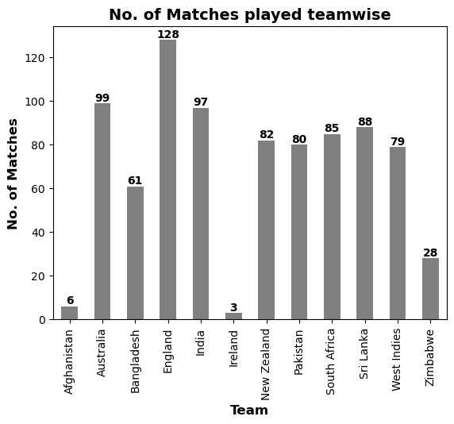
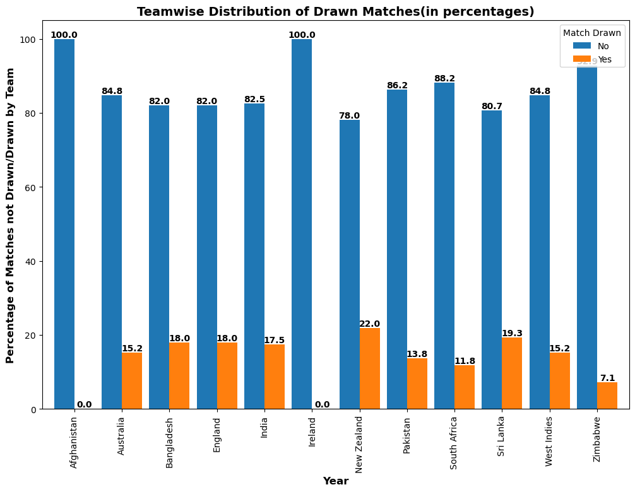
Exploratory Data Analysis: (contd.) Separate bar plots to show the no. of matches played and distribution of drawn matches, teamwise .

Slide 8
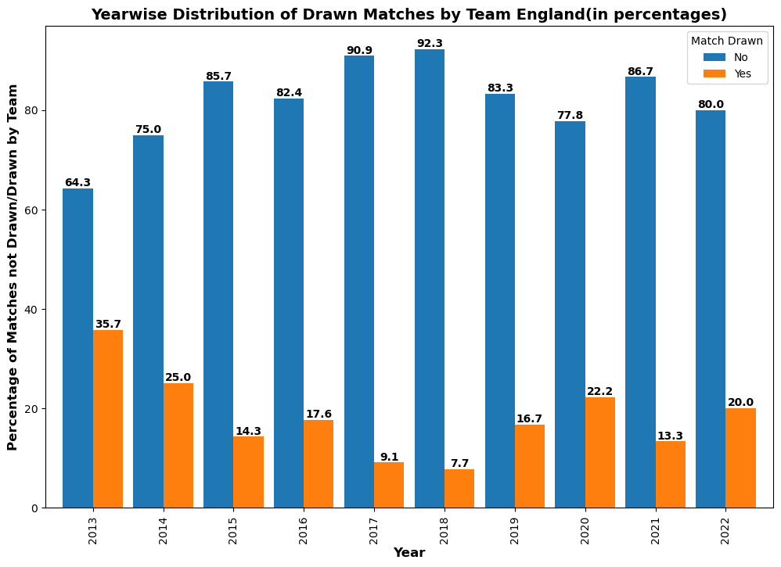
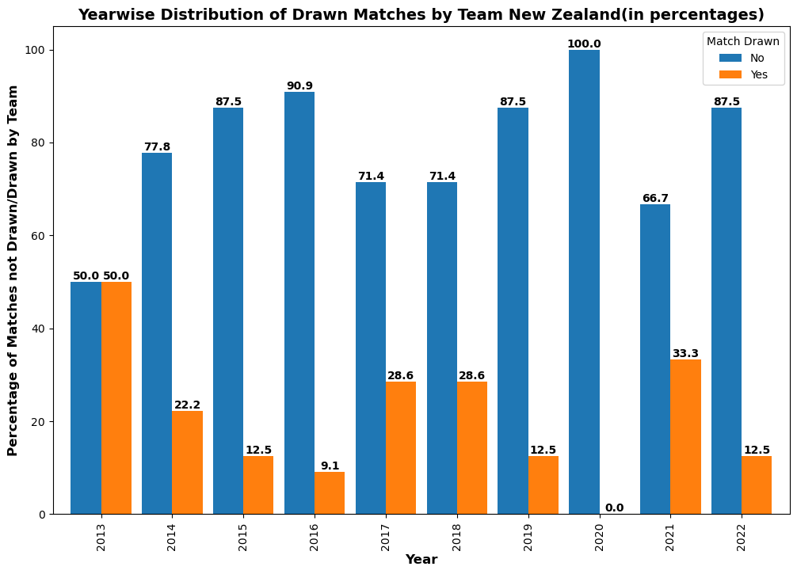
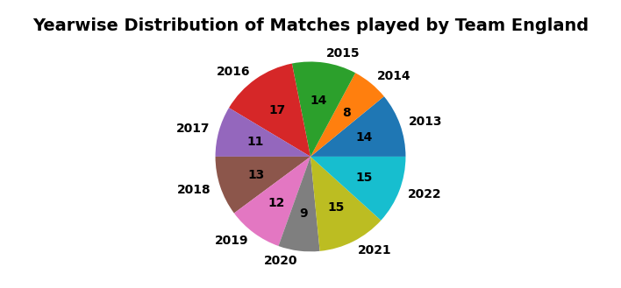
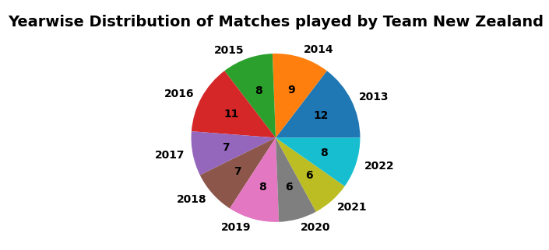
Exploratory Data Analysis: (contd.) bar plots to show the yearwise distribution of drawn matches and Pie charts to show Yearwise distribution of number of matches played, teamwise.
Team England -
Team Newzealand -

Slide 9
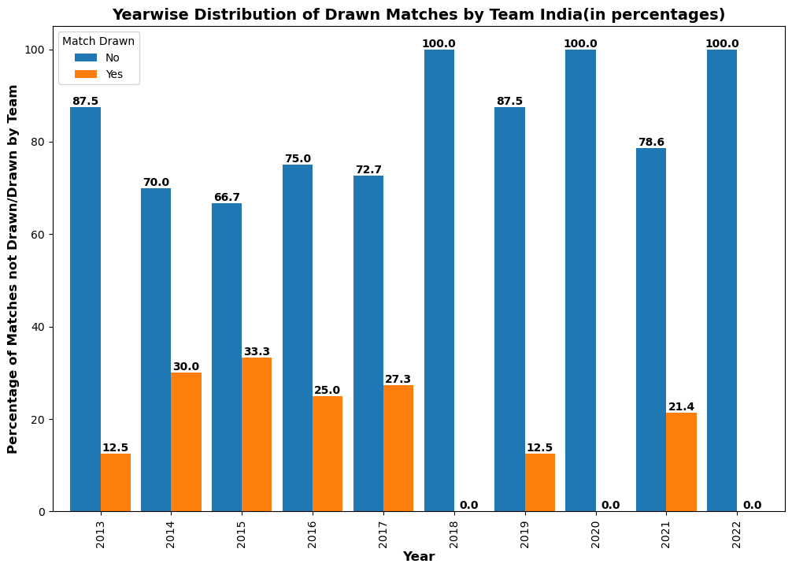
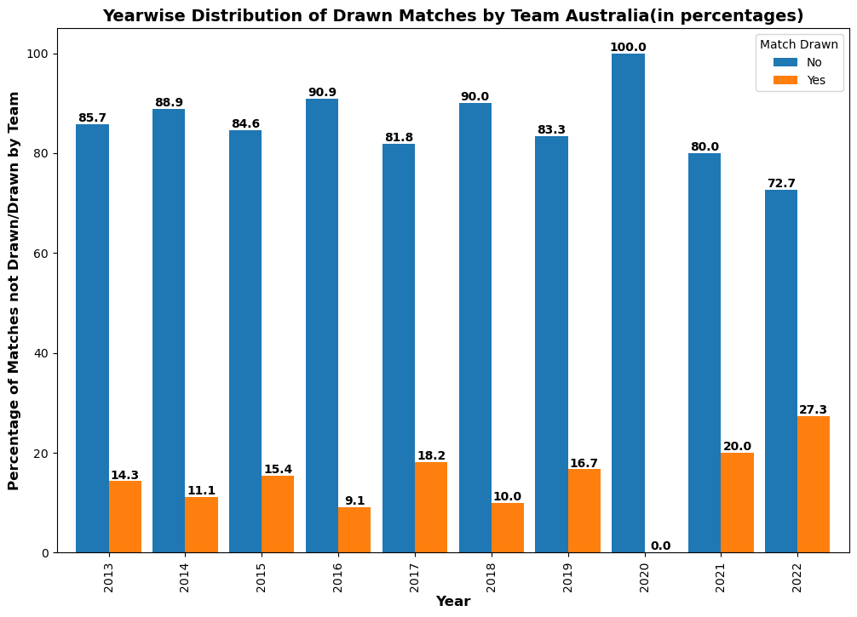
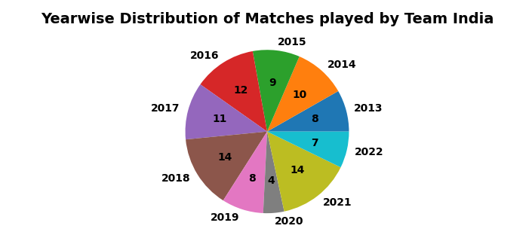
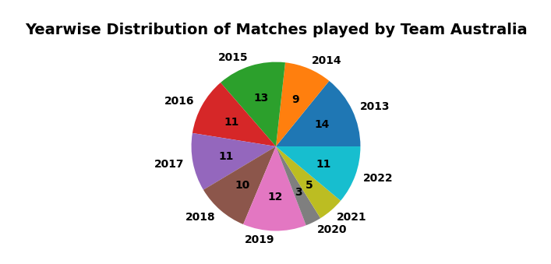
Exploratory Data Analysis: (contd.) bar plots to show the yearwise distribution of drawn matches and Pie charts to show Yearwise distribution of number of matches played, teamwise.
Team India -
Team Australia -

Slide 10
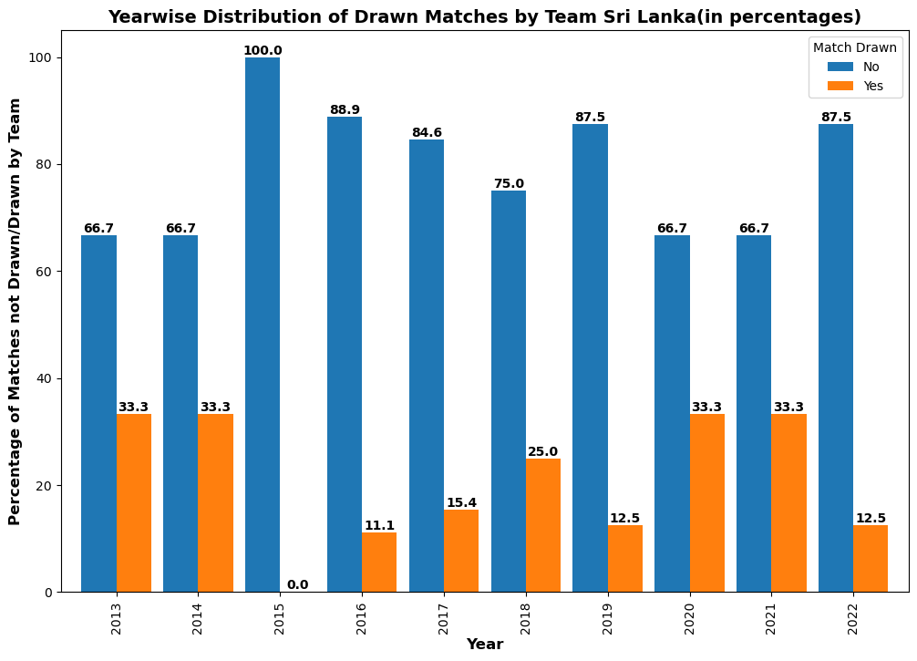
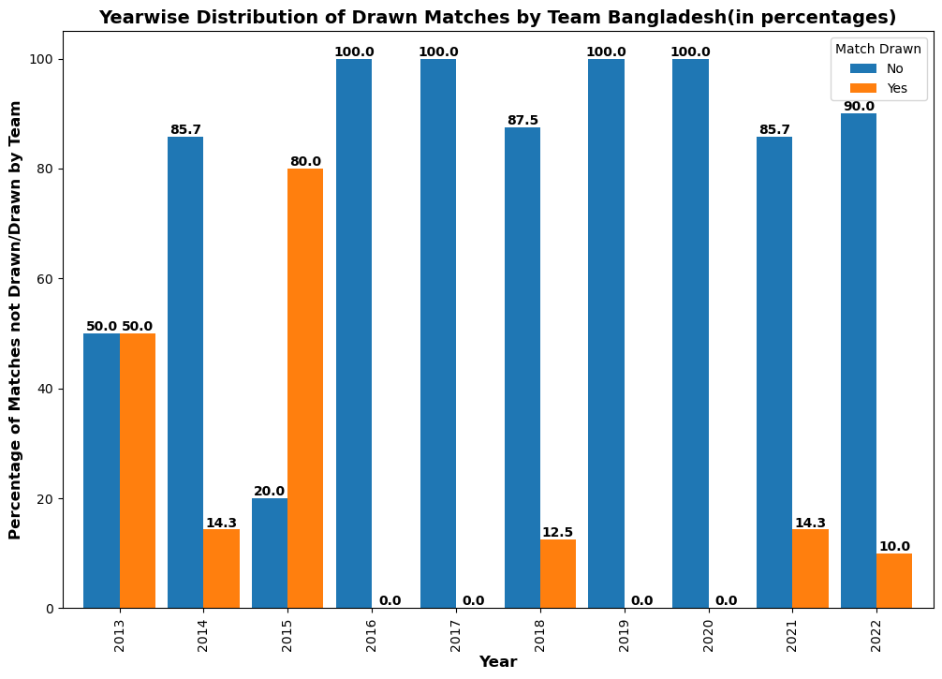
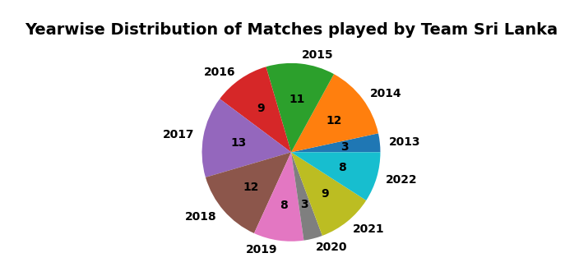
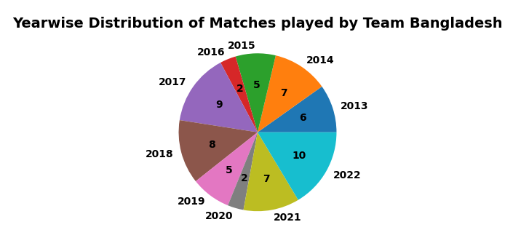
Exploratory Data Analysis: (contd.) bar plots to show the yearwise distribution of drawn matches and Pie charts to show Yearwise distribution of number of matches played, teamwise.
Team Srilanka -
Team Bangladesh -

Slide 11
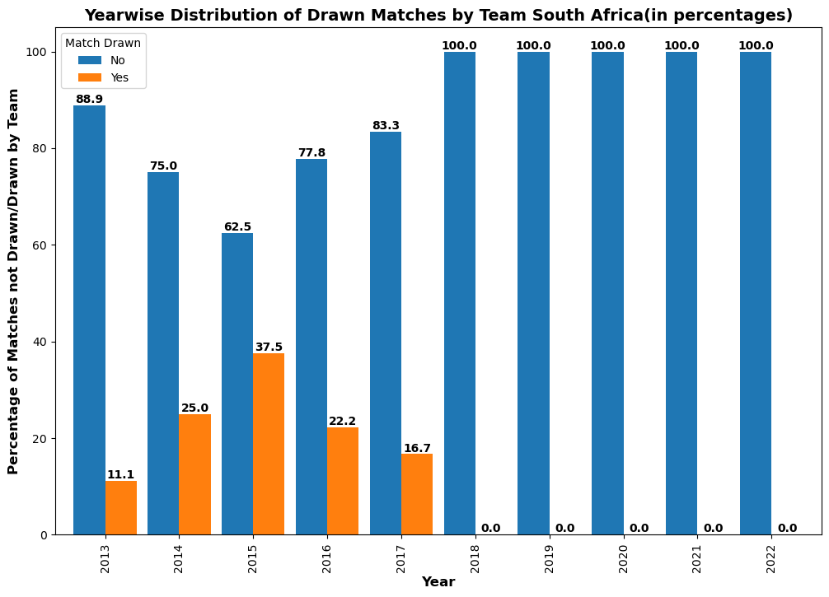
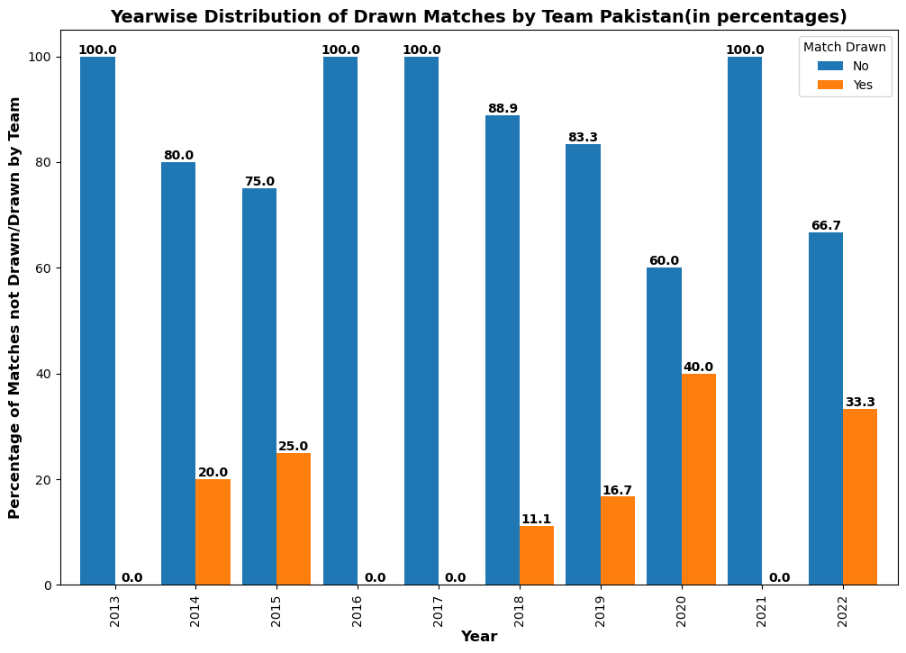
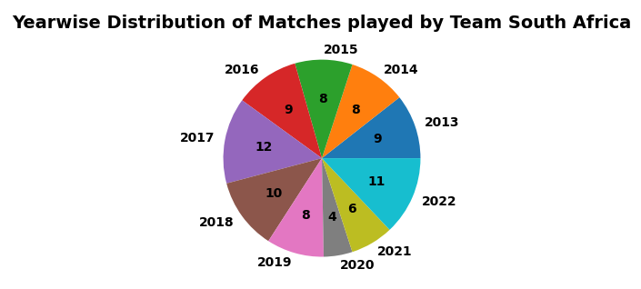
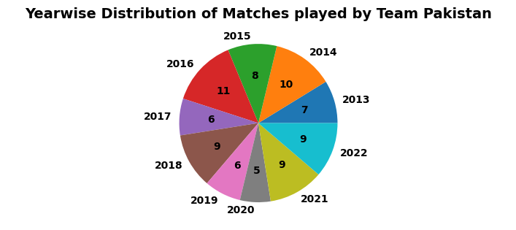
Exploratory Data Analysis: (contd.) bar plots to show the yearwise distribution of drawn matches and Pie charts to show Yearwise distribution of number of matches played, teamwise.
Team South Africa -
Team Pakistan -

Slide 12
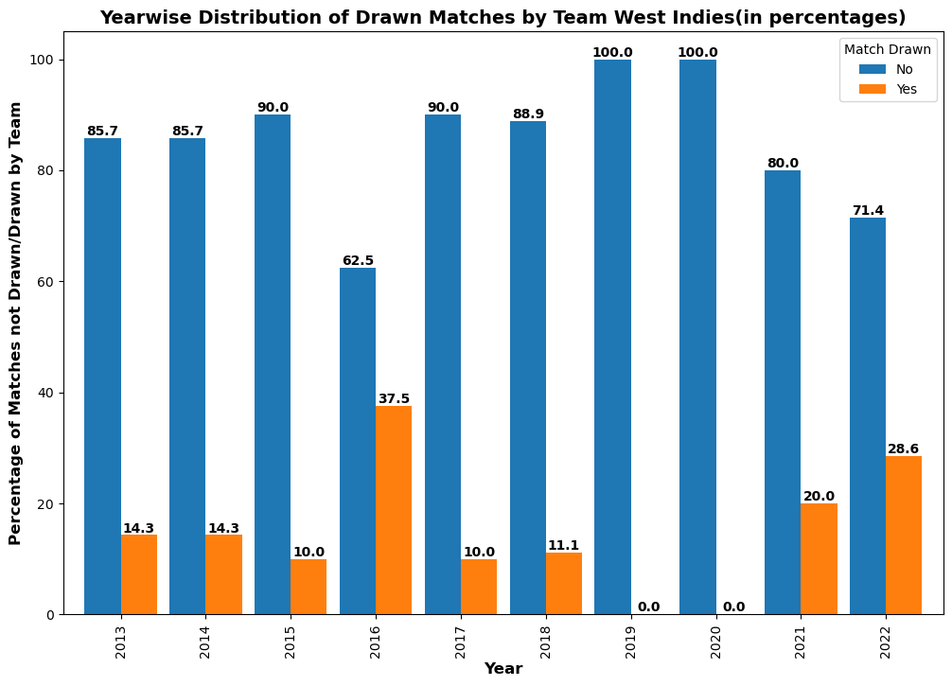
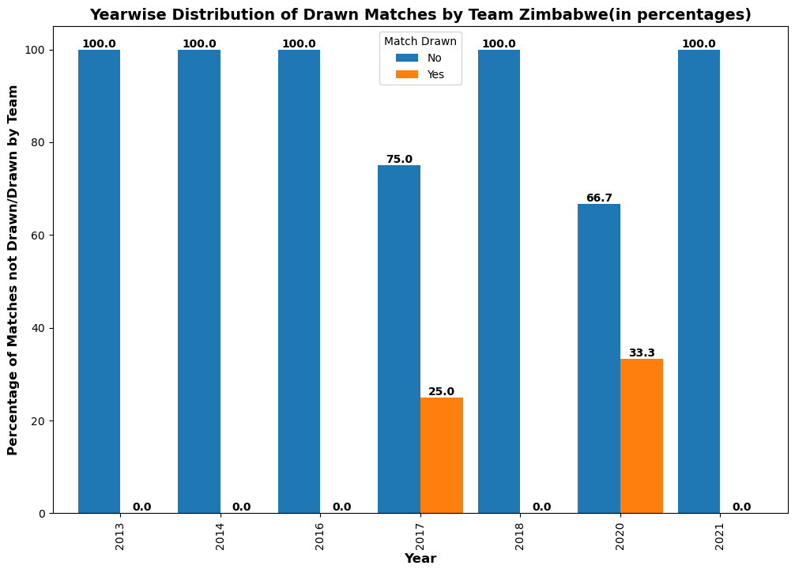
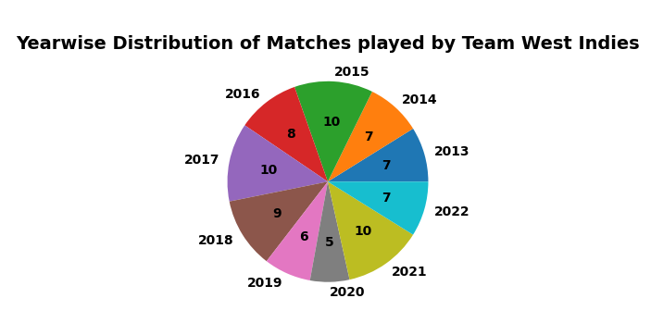
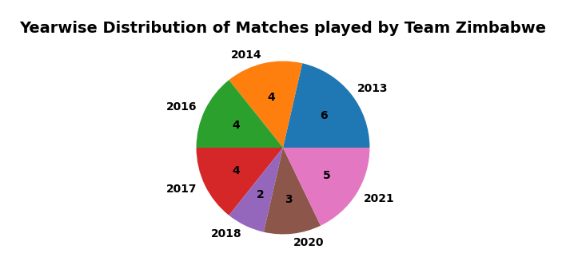
Exploratory Data Analysis: (contd.) bar plots to show the yearwise distribution of drawn matches and Pie charts to show Yearwise distribution of number of matches played, teamwise.
Team WestIndies -
Team Zimbabwe -

Slide 13
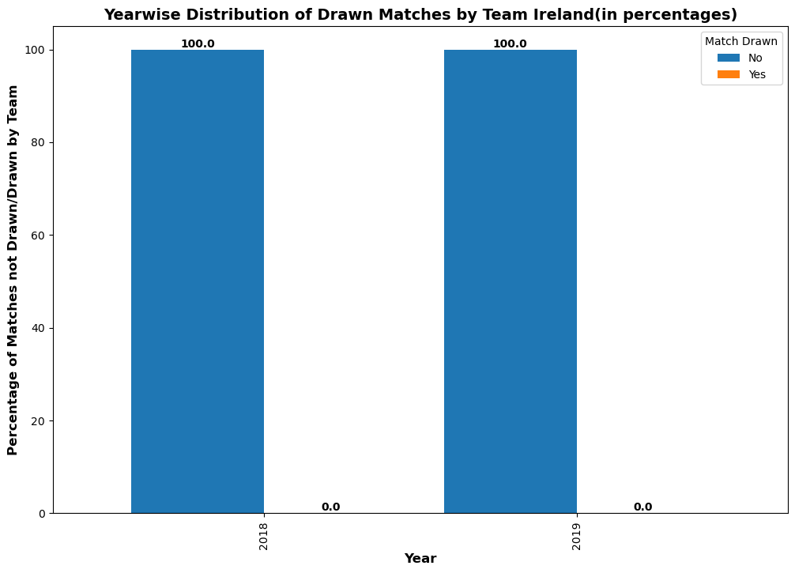
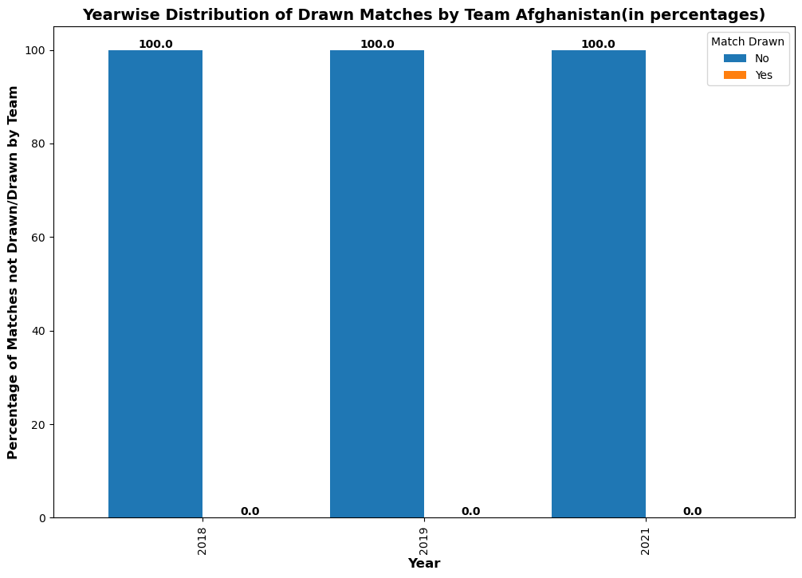
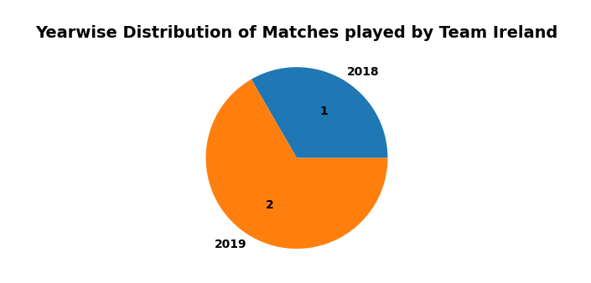
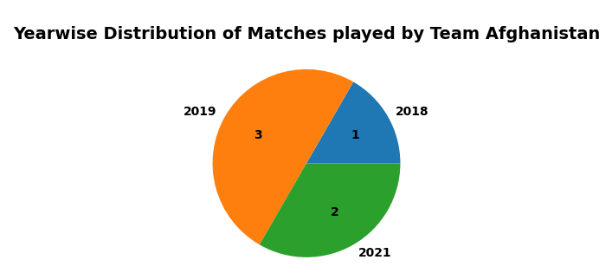
Exploratory Data Analysis: (contd.) bar plots to show the yearwise distribution of drawn matches and Pie charts to show Yearwise distribution of number of matches played, teamwise.
Team Ireland -
Team Afghanistan -

Slide 14
Conclusions -
Draw matches percentage has decreased from 23.3 in 2013 to 10.3 in 2019 and has increased steadily to 16.7 in 2022.
England cricket team has played most number of matches(128) from 2013-2022 and have a draw match percentage of 18.
Among teams which have played over 50 matches in this span, South Africa has least draw match percentage(11.8) followed by Pakistan(13.8), Australia(15.2) and West Indies(15.2).
The above data indicates that South Africa has played most aggressive brand of cricket to get results in as many matches as possible and many teams have started adopting similar strategies.

Slide 15

THANK YOU

